Slide 1
Files
ECS 30

Slide 2
Motivation
Information in your program only lasts while your program is running
What do you if you want our program to be able to pick up from where it left off?
Save information that will last after your program finishes running?
Make permanent changes to your computer
Even if your program could run forever your would still lose the information in it when you had to turn your computer off
This is because running programs are stored in memory (RAM) and the contents of memory are lost whenever power is lost
This is why support people always tell you to turn off your machine and then turn it back on as the first fix
This will put the machine in a well tested state and hopefully whatever path you took to get your error you won’t go down again
Files are located are your hard drive and will persist even when power is lost

Slide 3
File Path
Every file has a unique specifier saying where it is located
There are two types of paths
Absolute: From the beginning of the file system
Relative: From where you are currently at in the file system
Think of the path like driving directions telling you how to get to where the file is at
If you were going on a trip from Davis to Las Vegas I would give you directions on how to get there
Since Davis is the starting point for all of our trips any path from Davis to anywhere would be the absolute path
If you stopped in Bakersfield and asked me for directions I could give you directions from
Bakersfield: which would be the relative path
Davis: which would be the absolute path

Slide 4
File Path
Beginning of the file system is called the root of the file system
On Linux and Mac it is /
On Windows it is C:\
Parts of the path are separated by the path separator
/ on Linux and Mac
\ on Windows
Think of it like turn here in our directions analogy

Slide 5
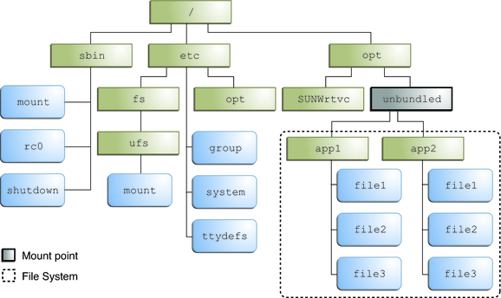
File Path Example
Assume current working directory is /opt/unbundled/app1
Absolute path to file1 in app1 is /opt/unbundled/app1/file1
Relative path to file1 in app1 is just file1 since we are already in app1
Absolute path to file3 in app2 is /opt/unbundled/app2/file3
Relative path to file3 in app2 is ../app2/file3

Slide 6
Opening/Closing Files
To open a file use the fopen function located in stdio.h
Syntax: FILE* fopen(char* filePath, char* mode)
filePath: is a string specifying the path to where the file is located
Mode: specifies how to open the file
r: for reading
Attempting to open a file for reading that does not exist will lead to an error
w: for writing
This will erase the contents of the file if it exists or create the file if it does not
a: for appending
Opens a file that already exists and new content will be added to the end
Returns a pointer to the opened file or NULL if the file failed to be opened
When you are done with a file you need to close it
Syntax: fclose(FILE* file)

Slide 7
Opening/Closing Example
FILE* fp = fopen(“hello.txt”, “r”);
FILE* fp2 = fopen(“bob.txt”, “w”);
FILE* fp3 = fopen(“sally.txt”, “a”);
fclose(fp);
fclose(fp2);
flclose(fp3);

Slide 8
Reading/Writing
Reading: fscanf(FILE* fp, format_str, arg1, arg2, …)
Just like scanf except the first argument is the FILE* to the file you want to from
Reading from a file that is opened for write/append only mode will result in an error
Writing: fprintf(FILE* fp, fomrat_str, arg1, arg2, …)
Just like printf except that the first argument is the FILE* to the file you want to write to
Writing to a file that is opened for read only mode will result in an error
To check if you are at the end of the file use feof
Bool feof(FILE* fp)
Returns true if you are past the end of the end of the file and false otherwise
Notice it says past the end of the file if you are at the end of the file feof will return false

Slide 9
File Location
To figure out how far into a file you are use ftell
Unsigned long long ftell(FILE* fp)
Returns the number of bytes past the beginning of the program you are currently at
To move within a file use seek
Int fseek(FILE* fp, int offset, int origin)
Move offset bytes in fp starting from origin
Origin is one of
SEEK_SET: beginning of file
SEEK_CUR: current location in the file
SEEK_END: end of the file
Returns 1 on success and 0 on failure

Slide 10
Extended Modes
When opening a file sometimes you need to be able to both read and write to it.
If you do add a + after the mode that you want to open it in
r+
Reading and writing. Can only be used if the file already exists
Will not delete the contents of the file
w+
Writing and reading
Opens the file if it exists and deletes the contents of the file. If the file does not exist it creates it
You can then read from and write to that file
a+
Appending and reading. Can only be used if the file exists

Slide 11
Binary Files
Up until now our discussion has focused on text files
Text files are files whose contents are meant to be interpreted as text
There are also binary files
Files whose contents are not meant to be interpreted as text
.png, .mp4, .jpeg, etc
To open a binary file we add b to the mode
“rb”, “wb”, “ab”, “rb+”, “wb+”, “ab+”

Slide 12
Binary Files - Reading and Writing
Reading: int fread(void* dest, int size, int count, FILE* fp)
Read at most count things from fp into dest where each thing is size bytes big
Returns the total number of elements read which can be less than size if the end of the file or an error is encountered
Writing: int fwrite(void* src, int size, int count, FILE* fp)
Write at most count things from src into the file pointed to by fp where each element is count big
Returns the number of elements actually written

